Slide 1
Hydra: Accurate Multi-Modal Leaf Wetness Sensing with mm-Wave and Camera Fusion​
Yimeng Liu, Maolin Gan, Huaili Zeng, Li Liu, Younsuk Dong, Zhichao Cao

Slide 2
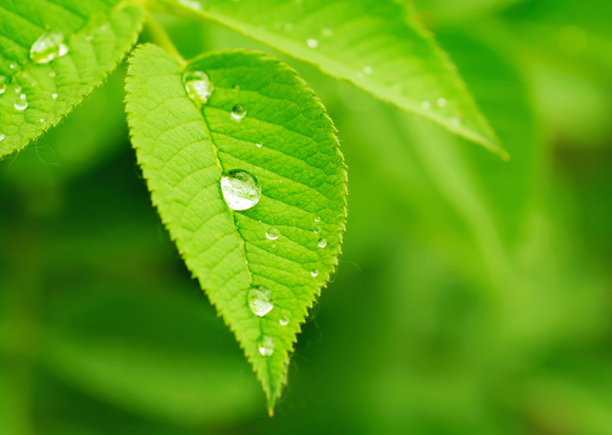
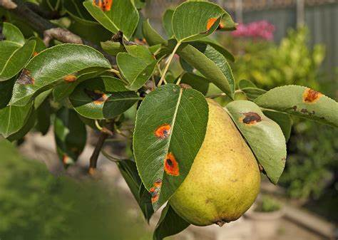
Plant Disease
Agriculture plays a crucial role in the global economy, contributing 4% to the worldwide GDP and over 25% in some developing countries
Notes:
Agriculture is essential to the global economy, contributing 4% to worldwide GDP and over 25% in some developing nations.
However, the rising frequency and intensity of plant diseases threaten productivity, food security, and biodiversity, particularly in vulnerable areas.
Leaf wetness, the presence of water on leaf surfaces from dew, precipitation, fog, or irrigation, is a key factor in the spread of plant diseases.
The duration of leaf wetness is crucial for the development of pathogen, making accurate Leaf Wetness Duration (LWD) detection critical for effective disease management.

Slide 3
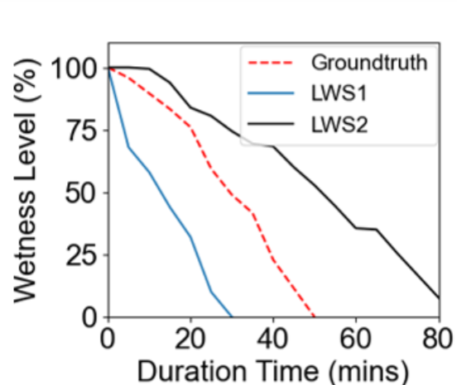
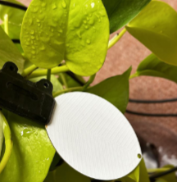
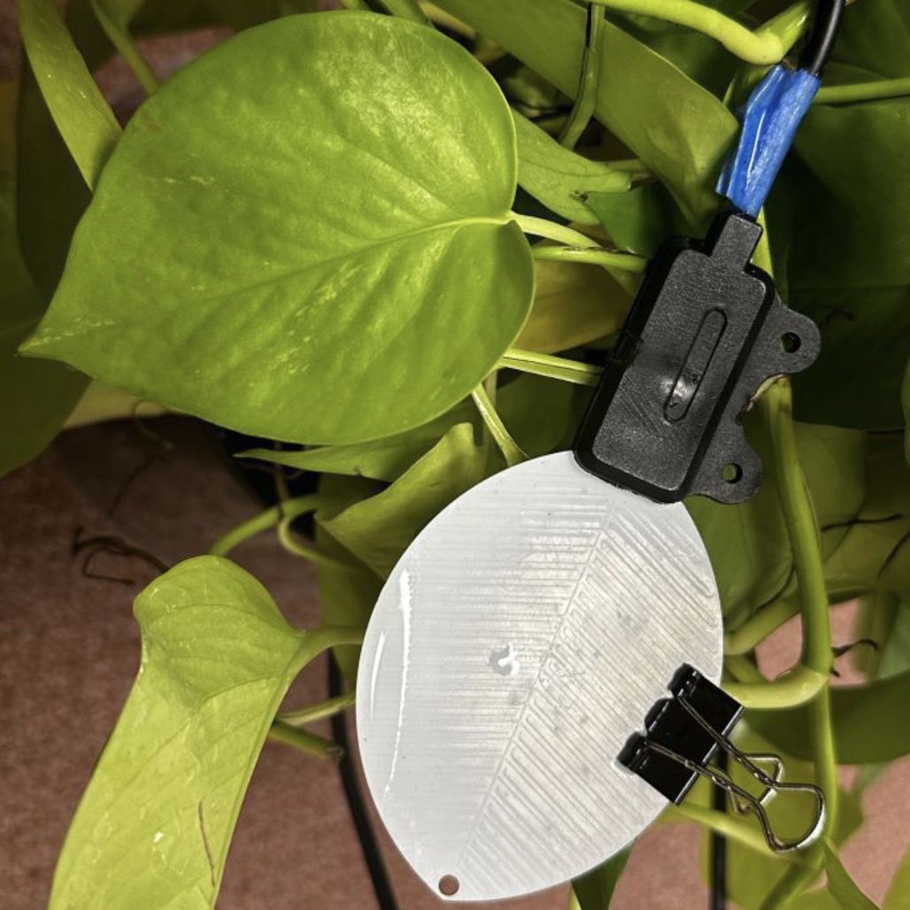
Existing Method
Leaf Wetness Sensor
Notes:
Various approaches have been introduced for LWD detection, with the Leaf Wetness Sensor being widely used in agriculture.
LWS mimics the shape and positioning of real leaves to simulate wetness detection through resistance changes.
[click] However, it utilizes synthetic leaves that differ from natural leaves in size, shape, and material, resulting in detection inaccuracies and errors.

Slide 4
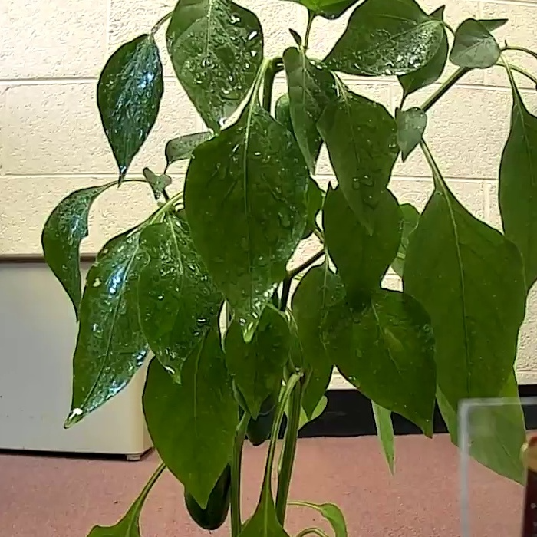
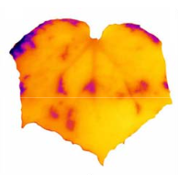
Existing Method
RGB Camera / Infrared Camera
Notes:
Cameras are widely used in leaf wetness detection.
They offer clear distinctions [click] between dry and wet leaves, with visible features such as water droplets that can be effectively detected using deep neural networks.

Slide 5
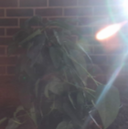
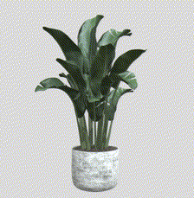
Existing Method
RGB Camera / Infrared Camera
Notes:
However, in real-world conditions, lighting can be a significant challenge.
During cloudy days, dawn, and nighttime, cameras struggle to capture useful information.
Additionally, plants are 3D structures, but the camera can only capture the front surface, leaving behind areas undetected.
This limitation prevents the camera from extracting information from parts of the plant that are been hidden.

Slide 6
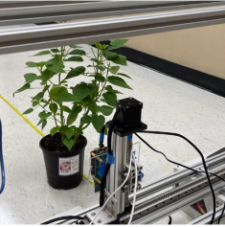
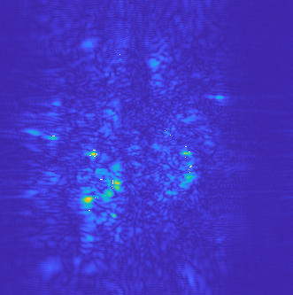
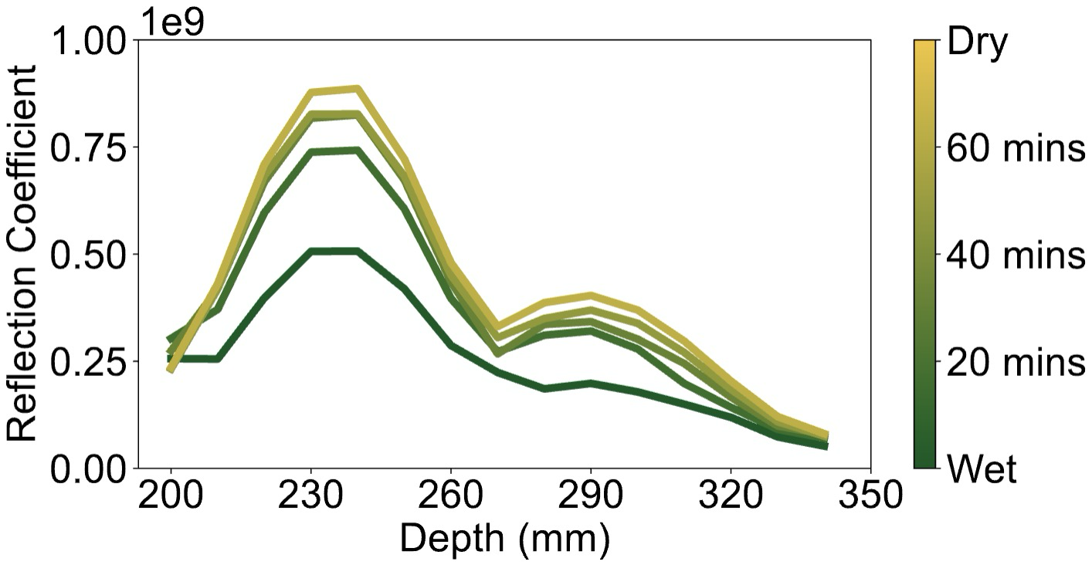
Existing Method
No existing single-modality leaf wetness sensing techniques can achieve high accuracy under various environmental conditions.
230 mm
SAR Image
mmWave Radar with Synthetic Aperture Radar (SAR)
Poster: mmLeaf: Versatile Leaf Wetness Detection via mmWave Sensing.
MobiSys 2023
Notes:
mm-Wave is another method for leaf wetness detection. It operates at higher frequency, offering a broad bandwidth that enables the detection of subtle changes in wetness.
Water change will exhibit unique permittivity, reflecting mm-Wave signals distinctly.
Synthetic Aperture Radar (SAR), widely used for high-resolution imaging, simulates a large aperture by leveraging the radar's relative motion to the target.
With high-resolution image, it could provide more detailed feature from the leaf surface
Using frequency-modulated continuous wave (FMCW) chirps, [click] SAR can capture cross-sectional images of plants, which reveal details at different depths.
In our setup on the leaf image, a stationary plant positioned about 200 mm from the radar. We extracted a cross section that is 230mm [click] from the radar shown as example on the right.
[click]
The image features, encircled by a red rectangle, designating the leaf surface information detected by the radar.
We monitor the plant transitions from wet to dry. [click]
The reflection signals increasing as the plant dries shows the protentional of using SAR to detect leaf wetness.
However, mmWave are easily been affected by the environment. In the windy and dynamic environment, the feature would dramatically decrease.
[click]
Hence, No existing single-modality leaf wetness sensing techniques can achieve high accuracy under various environmental conditions.

Slide 7
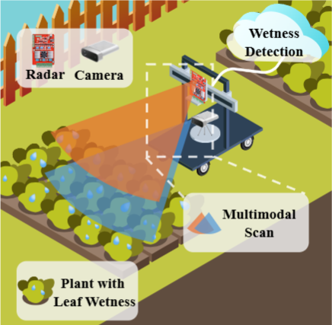
Hydra Overview
A multi-modal system combining RGB camera and mm-Wave radar to detect whether the leaf status is wet or dry.
Notes:
We introduces Hydra a multi-modal system combining RGB camera and mm-Wave radar to detect whether the leaf status is wet or dry, achieving high accuracy in leaf wetness detection.

Slide 8
Design Challenge
Multi-Modality Fusion
3D-Level
Detection
Environment Robustness
Notes:
In the design of Hydra, it involved three design challenge which is

Slide 9
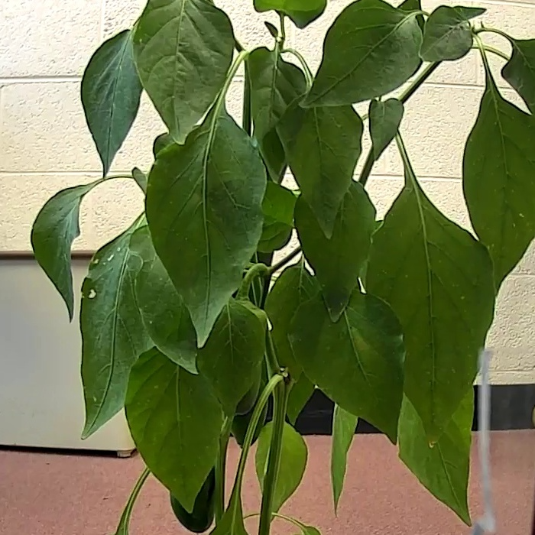
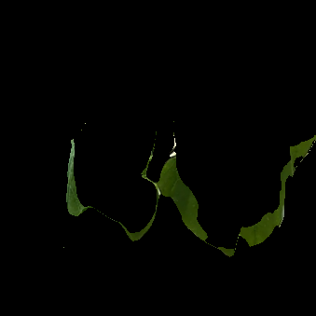
Challenge 1: Multi-modality Fusion
RGB Camera Image
SAR Image
Notes:
The first challenge in multi-modality fusion is the mismatch in dimensions between the captured images.
The RGB camera provides a 2D image where multiple depths are combined in a single view but the SAR image could only provide for single depth.
On the left, we have a depth map where brighter areas indicate regions closer to the camera.
Our approach is inspired by the idea of isolating a specific depth from the RGB image.
By selecting a particular depth [click] from the depth map and [click] applying it as a mask over the RGB image, we can extract a cross-section of the plant at that specific depth,
It can effectively isolate
the leaf section within the RGB image that corresponds to the desired depth.

Slide 10
Challenge 1: Multi-modality Fusion
Multi-modality Fusion Model
Dynamic
Parameter
Feature Extraction Module
Global Average Pooling
Notes:
The SAR image serves as a specific depth map combined with reflection information, which we use to mask the RGB image.
By overlaying [click] the SAR image on the RGB data, we effectively merge mmWave reflections with the visual details captured by the camera.
To integrate the two modalities effectively, we apply a Dynamic Parameter [click] that adjusts the weighting between the RGB and SAR images dynamically.
It can efficiently balance between two modality and overcome their own limitations.
[click]
Next, we feed the combined image into a feature extraction module to identify wetness features, followed by a Global Average Pooling layer for summarizing these features.

Slide 11
Challenge 2: 3D-Level Detection
Challenge 3:
Environment Robustness
Model Training
Transformer Encoder
De-emphasize RGB camera
Classifier
Data Augmentation
Notes:
The multi-depth module leverages a transformer encoder to process depth-wise data, allowing for more comprehensive feature extraction across multiple layers of leaf structure.
After the transformer encoder processes the data, a classifier is used extracted final result.
[click]
During model training, we apply strategies such as de-emphasizing the RGB camera input since the camera has a more obvious feature that can be easily extracted. This technique could enhance the model to more focus on the SAR and multi modality fusion features.
Additionally, we use data augmentation techniques to enhance the model’s robustness, ensuring it can adapt to diverse environmental scenarios. This approach helps the model better generalization , allowing for accurate detection across different field conditions.

Slide 12
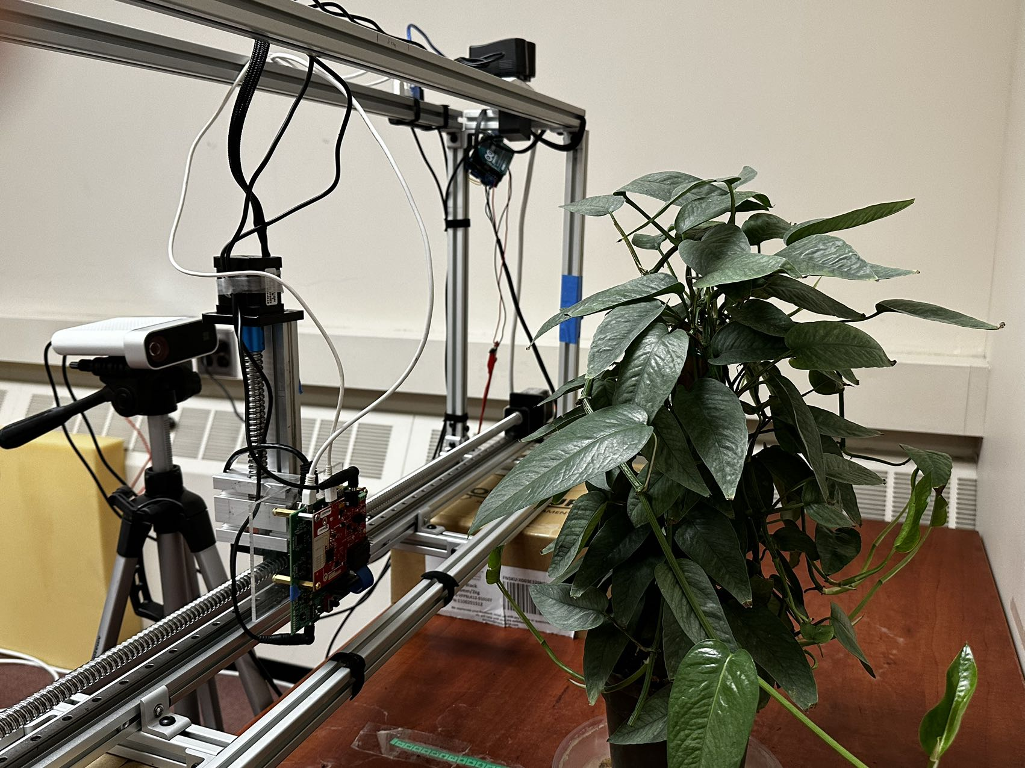
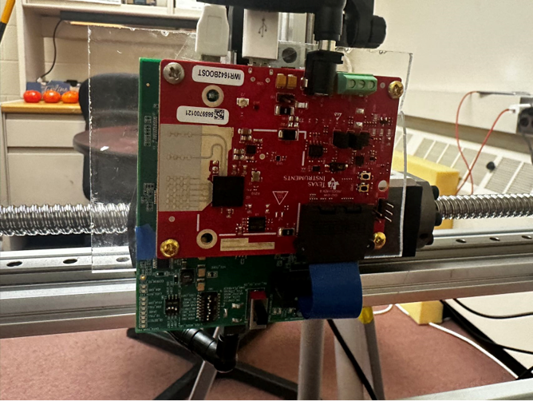
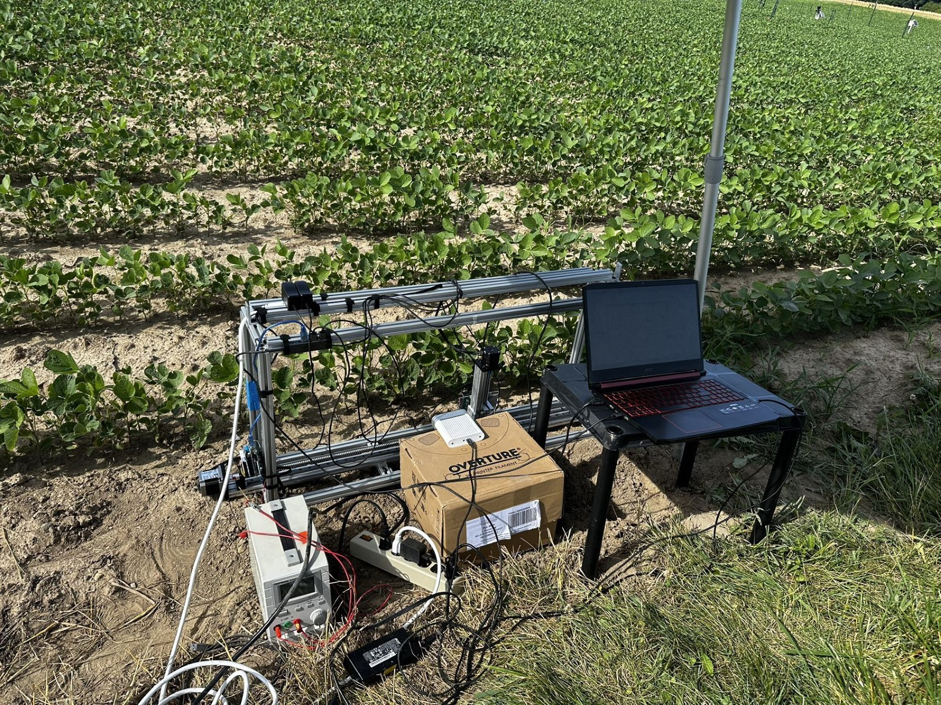
Implementation
Camera
mmWave
mmWave Radar: TI IWR 1642
Testbed
Camera
Workstation
Azure Kinect Camera
Power Bank
Notes:
Our implementation uses a TI IWR1642 mmWave radar and an Azure Kinect camera.
in the Indoor environment, the radar is mounted on a linear scanning platform for controlled measurements.
Here is our setup for the indoor and real field environment

Slide 13
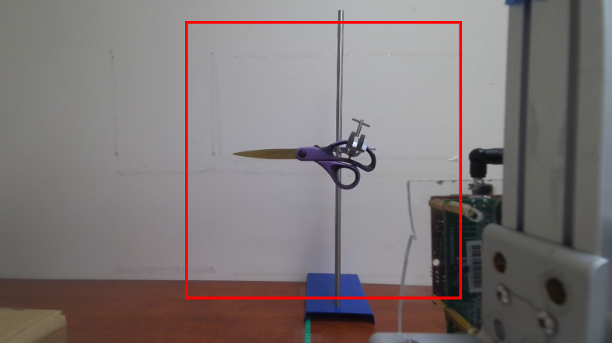
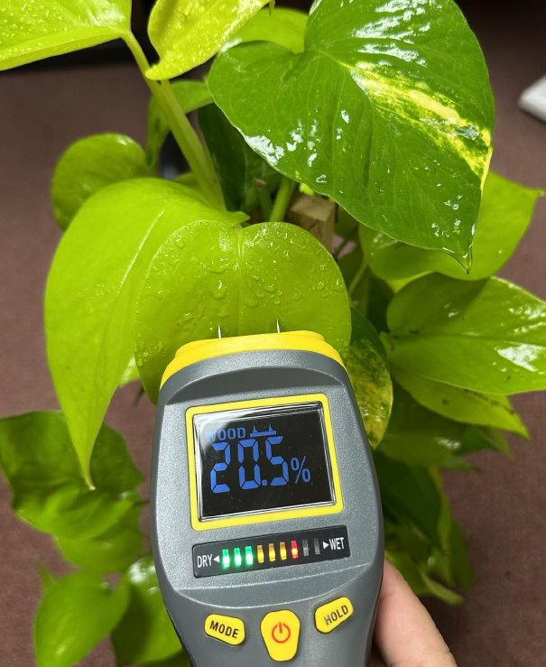
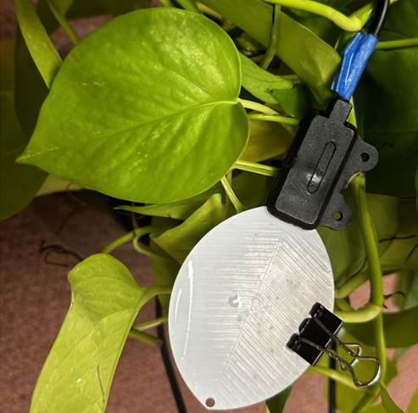
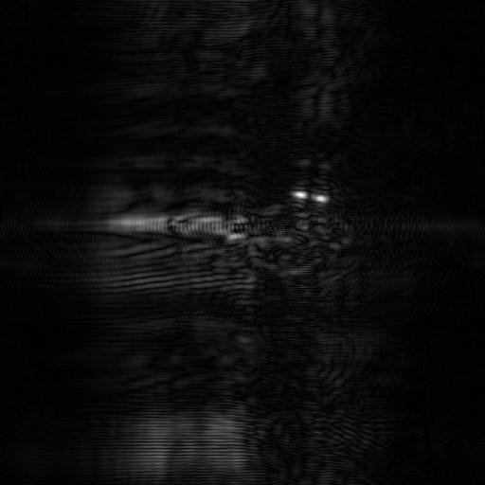
System Preparation and Data Collection
Calibration
Ground Truth
Baseline
Moisture Meter
Leaf Wetness Sensor
Notes:
For system preparation, we used a scissor to capture camera and SAR image to ensure they have the same field of view.
We established ground truth with a moisture meter, providing accurate leaf wetness levels, and used a Leaf Wetness Sensor (LWS) for baseline comparison.

Slide 14
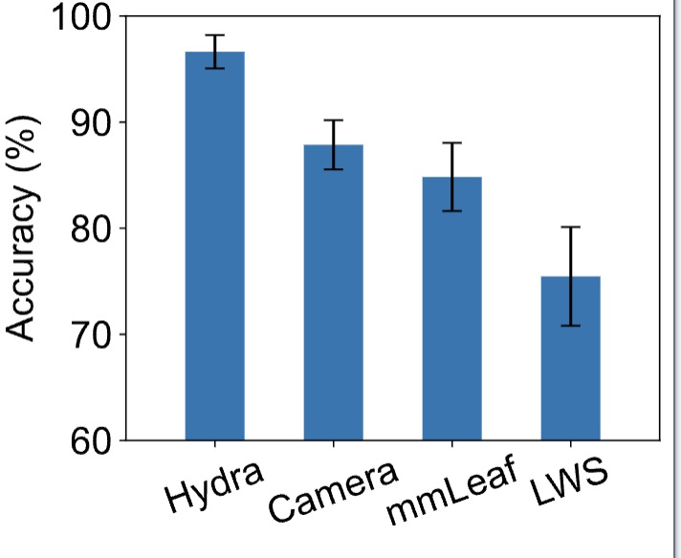
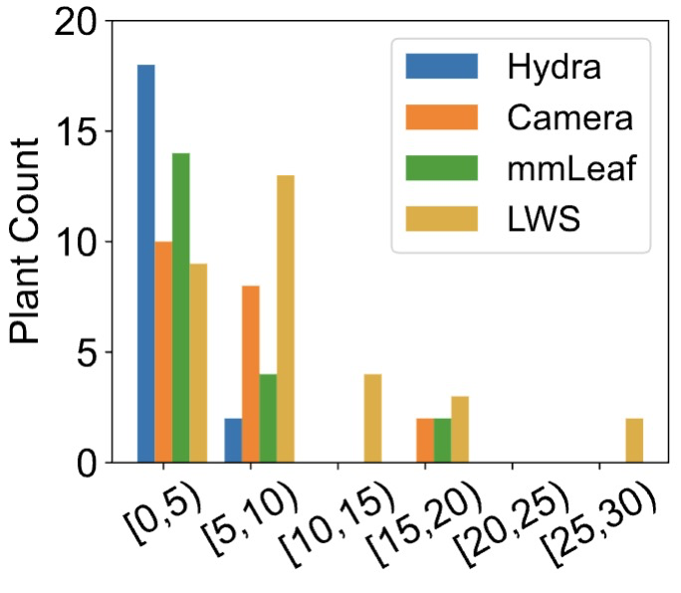
Evaluation
Hydra achieve accuracy for more than 96% and the leaf wetness duration error in less than 5 mins
Notes:
In our evaluation, Hydra achieved the highest accuracy at over 96%, outperforming the other methods.
Additionally, Hydra maintained a leaf wetness duration error of less than 5 minutes showing better precision compare with other modalities.

Slide 15
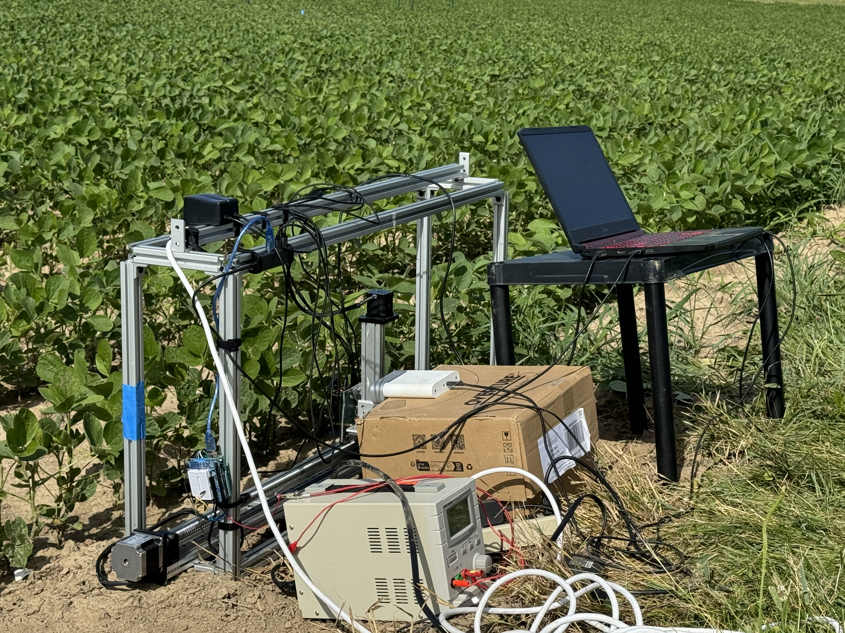
Evaluation
Hydra maintains high accuracy for more than 90% across different real field scenarios.
Notes:
We evaluate Hydra with different leaf shapes including large leaf side down and small leaf side up which are most popular in the real world.
Hydra maintained stable accuracy around 94%.
We also evaluate under outdoor and real field environment.
In all the environment, Hydra consistently achieved high accuracy, maintaining over 90 accuracy.

Slide 16
Conclusion
Hydra is the first contactless, multi-modality sensing system designed for accurate, robust, and efficient Leaf Wetness Duration detection.
We've incorporated novel multi-modality fusion techniques and utilize a novel 3D detection model for classification.
Hydra shows strong performance in complex outdoor scenarios and the real farm, highlighting its adaptability across diverse environments.
Notes:
Hydra is the first contactless accurate sensing system for leaf wetness duration detection.
Also, it incoperate with novel multi-modality fusion technique and 3d detection model for classification.
It shown robust performance under complex and real farm environment.

Slide 17
Hydra: Accurate Multi-Modal Leaf Wetness Sensing with mm-Wave and Camera Fusion​
Yimeng Liu
liuyime2@msu.edu
Michigan State University

