Slide 1
Proteus: Enhanced mmWave Leaf Wetness Detection with Cross-Modality Knowledge Transfer
Yimeng Liu, Maolin Gan, Huaili Zeng, Yidong Ren, Gen Li, Jingkai Lin, Younsuk Dong, Xiaobo Tan, Zhichao Cao
ACM SenSys 2025

Slide 2
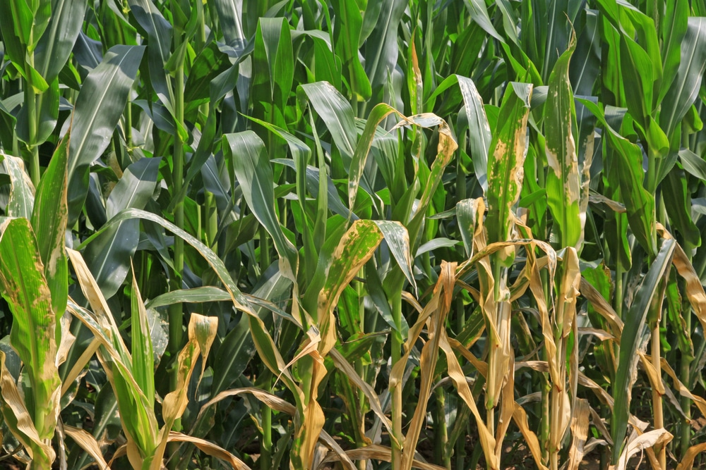
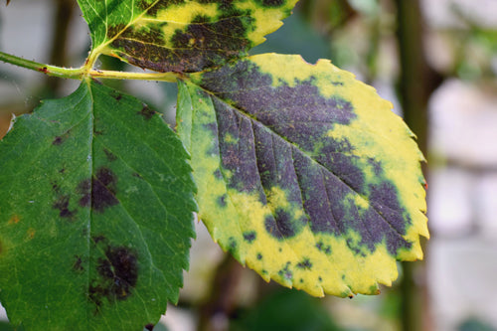
Plant Disease
Plant disease lead to substantial yield losses and ecological damage, costing an estimated 220 billion annually.
Notes:
The rising frequency and severity of plant disease outbreaks threaten global food security, agricultural productivity, and biodiversity.
These outbreaks, driven by pathogens such as fungi, bacteria, and viruses, lead to substantial yield losses and ecological damage, costing an estimated 220 billion annually.

Slide 3
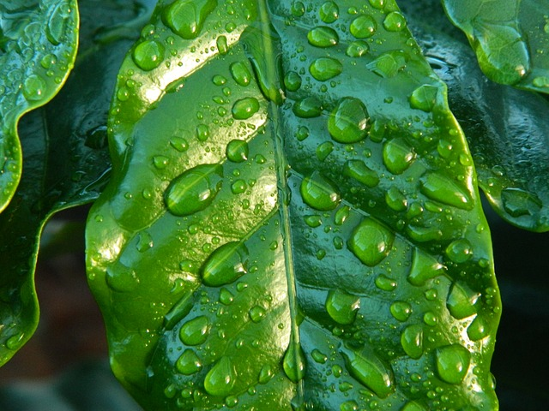
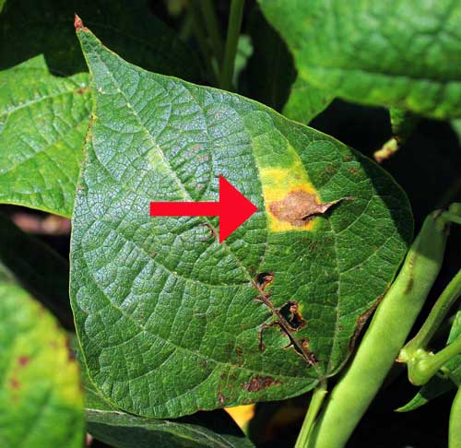
Leaf Wetness
Notes:
In effective disease management, a standout metric here is Leaf Wetness Duration, which tells us exactly how long water remains on the leaf surface.
By measuring LWD accurately, we can predict high‐risk periods and target interventions precisely, protecting crops like strawberries, cucumbers, and cherries before an outbreak takes hold.

Slide 4
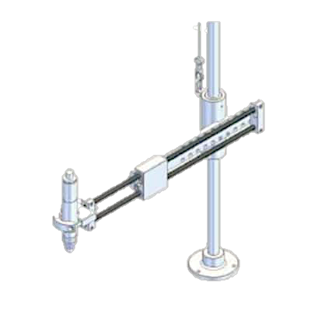
Existing Work
mmWave Radar with Synthetic Aperture Radar
High-Resolution
Wetness Sensitive
Environment Robustness
Notes:
Existing leaf wetness detectors are focus on mmWave Synthetic Aperture Radar
It exploit the short radar wavelength and synthetic‐aperture processing to produce high‐resolution images capable of resolving individual drop.
Also it is sensitive to the wetness that can have directly respond to water on the leaf and remain environment-robust, unaffected by shadows, lighting, or partial occlusion.

Slide 5
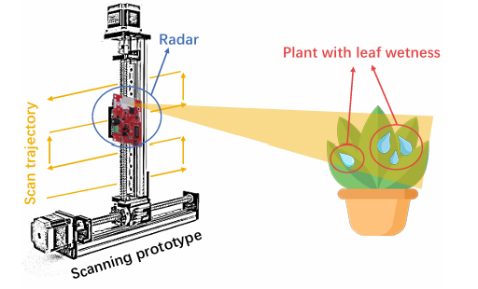
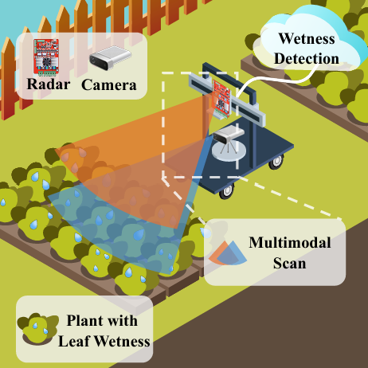
Existing Work
No existing study has conducted an in-depth analysis of the SAR‐specific features
mmLeaf: MobiSys-Poster 2023
Hydra: MobiCom 2024
Notes:
Early work in MobiSys ’23 introduced mm-Leaf, the first system to apply SAR imaging to leaf-wetness detection, but it struggled with low accuracy ​.
In MobiCom ’24, the state-of-the-art Hydra model fused mmWave radar SAR with RGB camera data, achieving much higher accuracy.
However, this multimodal approach faces real-world deployment challenges in farm settings—sensor alignment, lighting and increased hardware complexity. Also, it is emphasize multimodal fusion rather than mmWave features.
However, there’s still a critical gap:No existing study has conducted an in-depth analysis of the SAR‐specific features
Hydra multi modality devleopment cost.

Slide 6
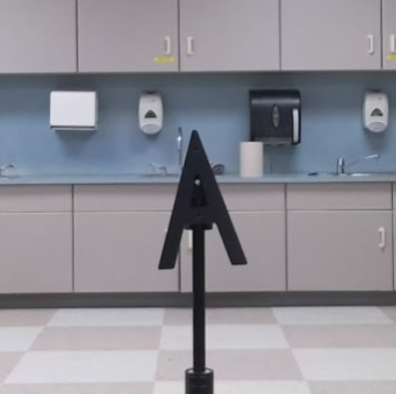
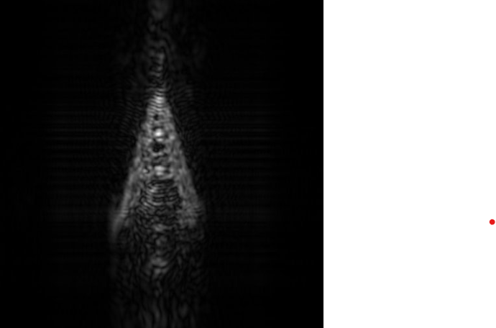
Challenge 1: Pixel Noises in SAR
Plastic Target “A”
SAR Image Result
Notes:
A key challenge in understanding mmWave feature is pixel noise.
Speckle noise is an inherent artifact of coherent radar that looks like salt-and-pepper speckles, which blur important surface textures ​.
This will results in a low signal-to-noise ratio, where the true wetness signal is almost indistinguishable from the noisy background ​.
On the screen you can see a plastic letter “A” on the left. which is a low-reflection target as leaf.
On the right is the SAR imaging that are blocked by the noise.

Slide 7
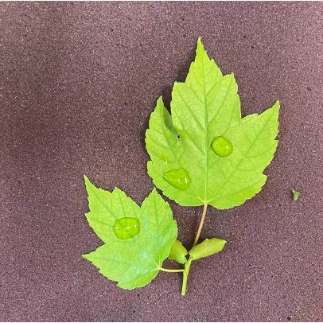
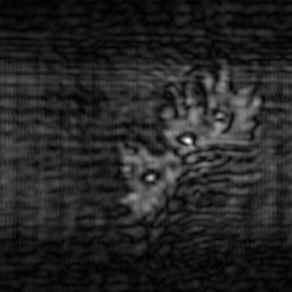
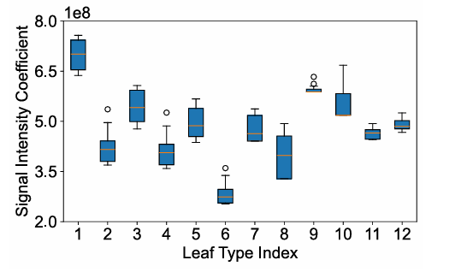
Challenge 2: Limited Pixel Intensity Features
RGB Image
SAR Image
Pixel Intensity Are Unstable
Notes:
Another challenge is for Limitation of Pixel Intensity Features. SAR intensity is inherently relative: the same drop can look brighter or darker depending on leaf roughness, density, and even its angle to the radar.
The surface properties and geometric factors cause intensity to fluctuate independently of actual wetness.
As a result shown in the right, a low-dimensional intensity-only feature space fails to generalize across different plants and deployment scenarios, leading to inconsistent and inaccurate wetness detection.

Slide 8
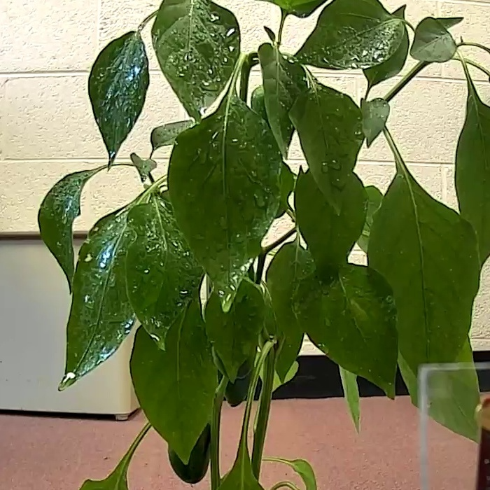
Challenge 3: Complex 3D Plant Structure
SAR image can hardly see the wetness feature for Complex 3D Structure.
Notes:
For whole plants with complex 3D geometry, the SAR result can be blurred.
In the RGB captures on the left, you can clearly see water circled in red. However, the corresponding SAR image at a 210 mm range is heavily blurred, making those wetness features nearly invisible.

Slide 9
System Design
SAR Image Enhancement
Teacher-Student
Feature Extraction
Depth
Fusion
Noise
Reduction
Feature Extraction
SAR Image
Classifier
Knowledge Transfer
Phase Angle
Notes:
To solve the challenge, we present Proteus.
First, We apply with SAR Image Enhancement.
We use a computer-vision based noise-reduction step to tackle speckle while keeping the feature of leaf surfaces.
Also, we perform phase augmentation by extracting the phase-angle map from the coherent SAR returns.
These phase shifts are sensitive to wetness, giving us an orthogonal feature channel beyond simple intensity.
Next, we feed both the denoised intensity image and the phase map into our cross-modal teacher–student network.
A pre-trained RGB model “teaches” the SAR model which patterns correspond to true wetness, transferring rich visual wetness cues into the radar domain.
Finally, we apply with depth fusion to extract 3D level information and classifier to extract the final result.
This three-stage pipeline produces high-clarity, feature-rich mmWave images that a lightweight classifier can use for accurate, robust leaf-wetness detection.

Slide 10
SAR Image Enhancement: Noise Reduction
Gaussian blur
Median Blur
Non-Local Means
Original
Denoised
Notes:
In the SAR image enhancement, we tackle the inherent speckle noise with a three-stage denoising pipeline:
firstly, a Gaussian blur smooths out high-frequency speckle;
second, a median filter removes salt-and-pepper artifacts;
and third, Non-Local Means denoising averages similar patches across the image to suppress residual noise yet retain fine texture details.

Slide 11
SAR Image Enhancement
Phase Angle Extraction
Notes:
The second for SAR image enhancement is to add phase angle for the wetness feature enhancement.
Proteus extracts the phase angle from the complex beat signal, giving us a pixel-wise map of how the radar wave’s phase shifts upon reflection.
Because a wet leaf’s dielectric constant and conductivity differ from a dry one, wetness alters the signal’s propagation speed and imposes measurable phase shifts​.
By fusing this phase information [click] with the denoised amplitude image, we build a richer, dual features representation that highlights subtle textural changes linked directly to leaf wetness.

Slide 12
Teacher-Student Network
Teacher-Student
Feature Extraction
Classifier
Student Network
Logits Loss
Depth Fusion
Conv2D
Residual Block
Residual Block
GAP
Phase Angle
Enhanced SAR Image
LSTM Block
Classifier
Distillation Loss
Teacher Network
…
ResNet-18
GAP
Depth Feature
RGB Image
Notes:
After the image enhancement, we apply with cross-modal teacher–student framework.
On the lower, the teacher network is a pre-trained ResNet-18 that processes an RGB image to produce a rich wetness feature vector after global average pooling.
Above it, the student network is a lightweight model followed by two residual blocks as input and similarly outputs a feature vector.
We train the student with two losses: a logits loss from its own classifier to ground-truth wetness labels, and a distillation loss that aligns its feature logits with the teacher’s.
Finally, these distilled SAR features feed into our depth-fusion LSTM, which integrates temporal context before a final classifier predicts wetness for 3D level information.

Slide 13
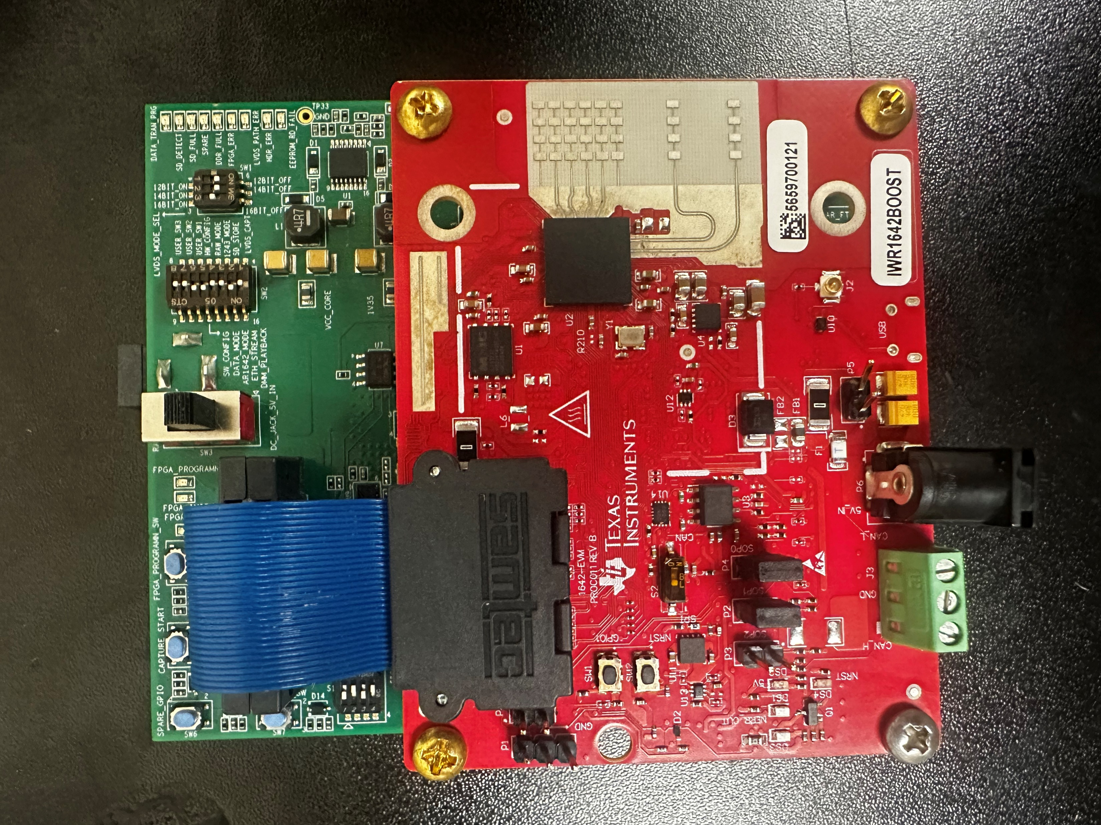
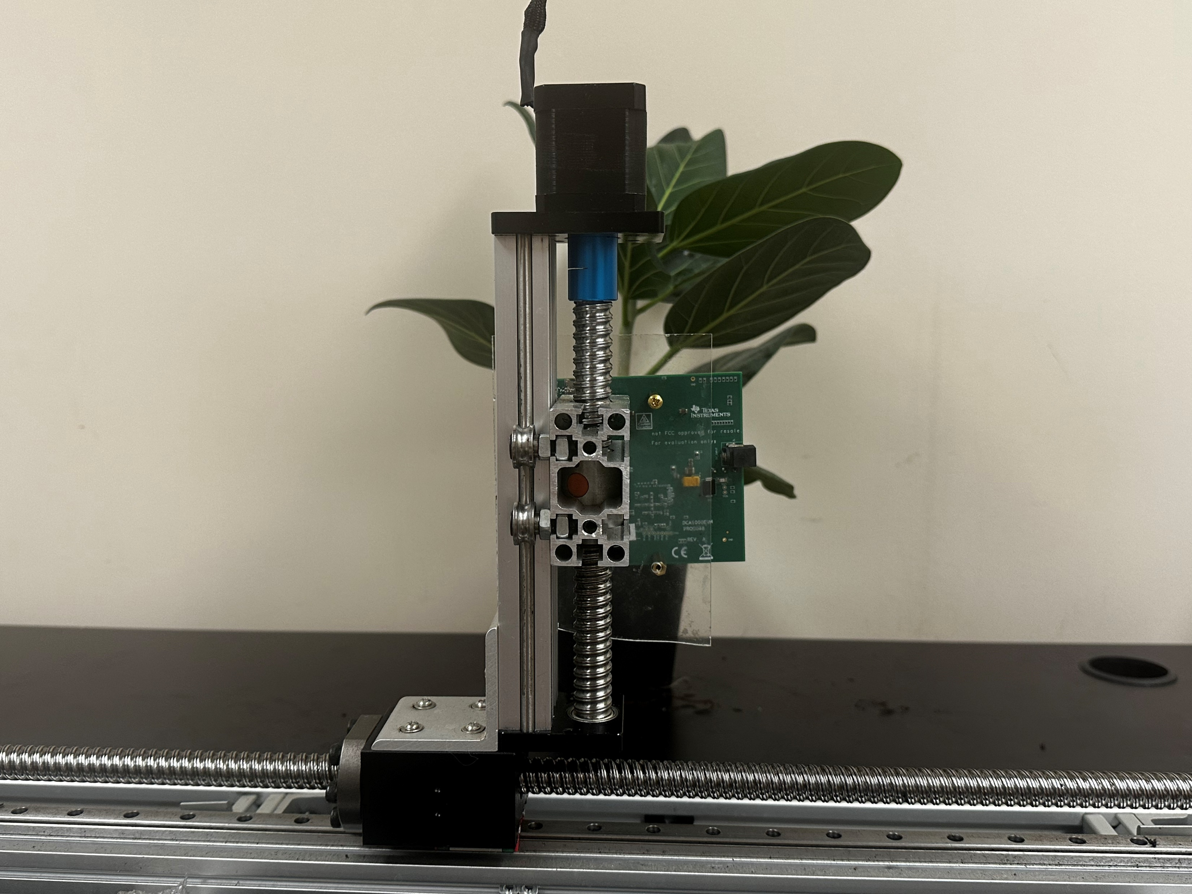
Implementation
Camera
2-Axis Testbed
$$\text{4}\text{Rx} ×\text{2}\text{Tx}$$
Training Dataset Collection Setup
DCA 1000
TI IWR1642
mmWave Radar: TI IWR 1642
mmWave Radar
Inference Dataset Collection Setup
Notes:
Our implementation uses a TI IWR1642 mmWave radar and an Azure Kinect camera.
in the Indoor environment, the radar is mounted on a linear scanning platform for controlled measurements.
Here is our setup to collect training dataset and inference dataset

Slide 14
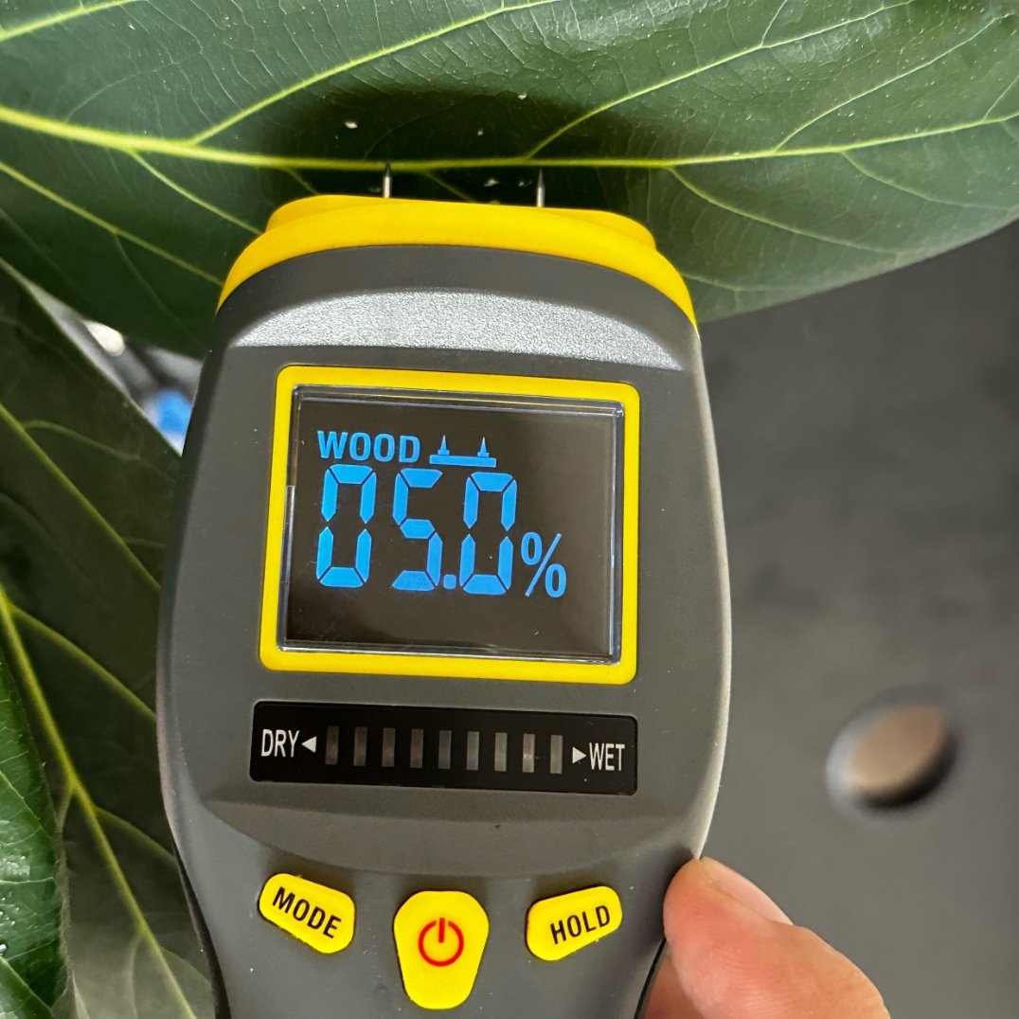
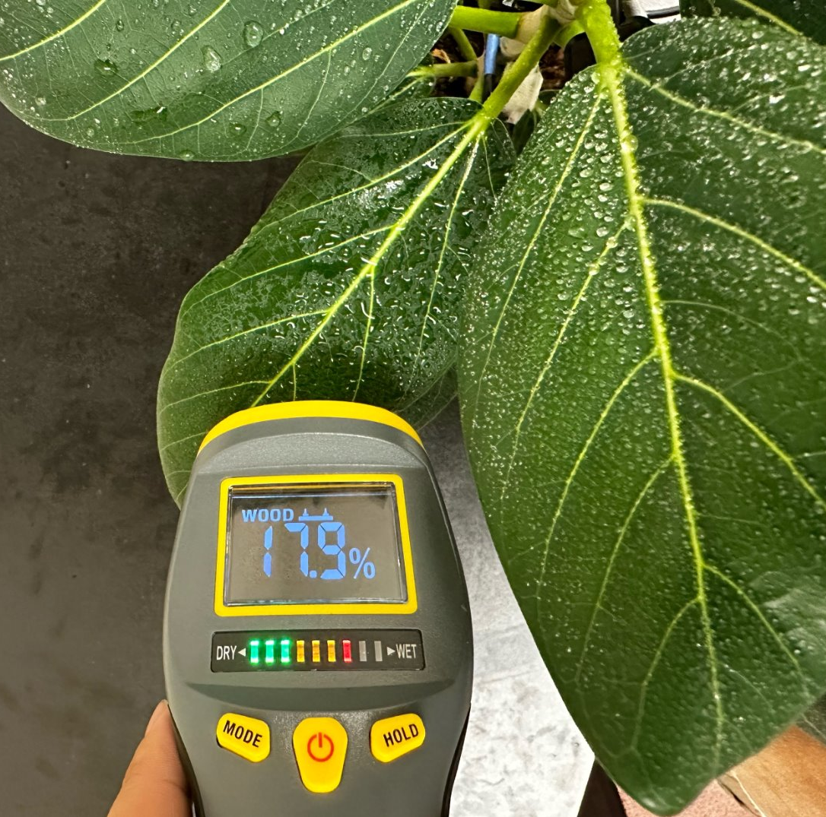
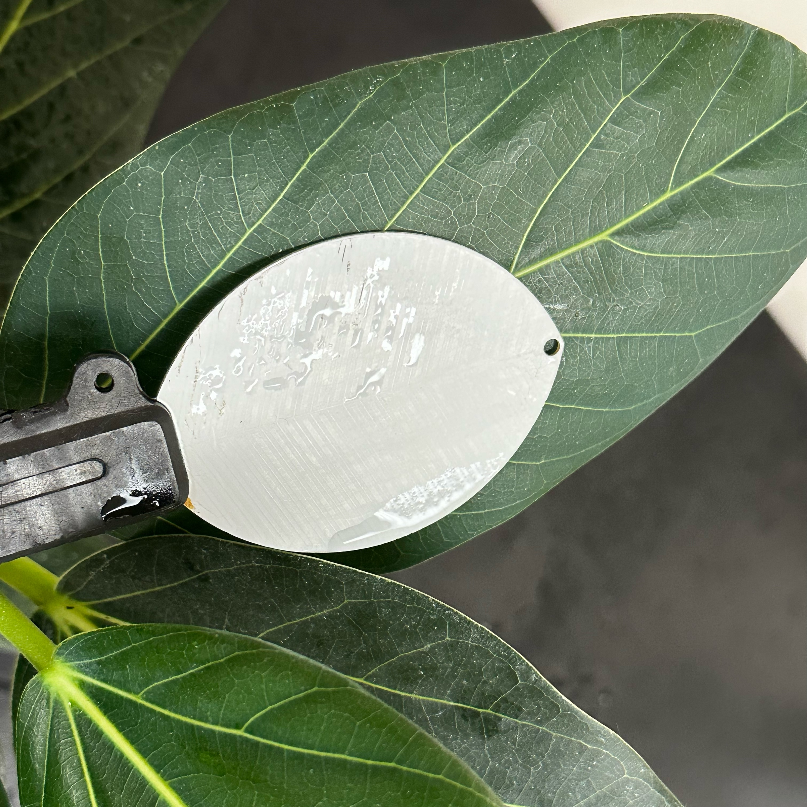
Groundtruth & Baseline
Moisture Meter
Leaf Wetness Sensor
PHYTOS 31
Notes:
In our experiment, we collected ground‐truth wetness measurements with handheld moisture meterr, which reports the percentage moisture on the leaf surface.
For the baseline collection we deployed a Phytos 31 leaf‐wetness sensor, a commercially standard probe that continuously measures electrical resistance across a leaf surface to indicate the presence and duration of water.

Slide 15
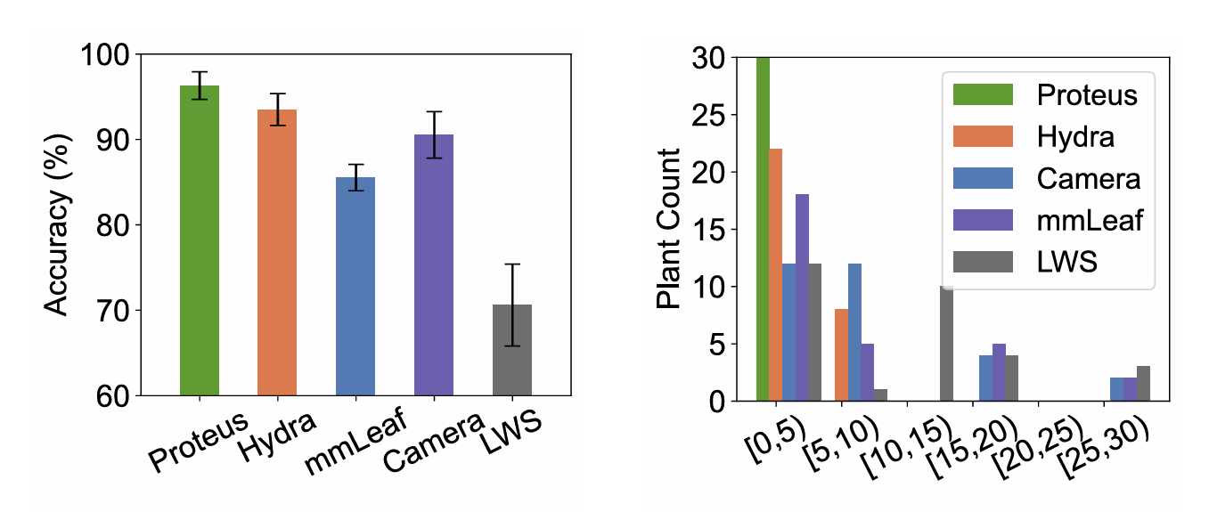
Evaluation
Proteus achieve accuracy for more than 96% and the leaf wetness duration error in less than 5 mins
Notes:
In our overall evaluation, Proteus achieves 96.3 % classification accuracy surpassing previous work​.
When we examine Leaf Wetness Duration error across all 30 test plants, Proteus places every measurement in the 0–5 min bin, demonstrating sub–5 minute timing precision.
In contrast, other methods distribute errors into larger time bins, highlighting Proteus’s superior accuracy and temporal resolution for real‐world disease‐management applications.
Why

Slide 16
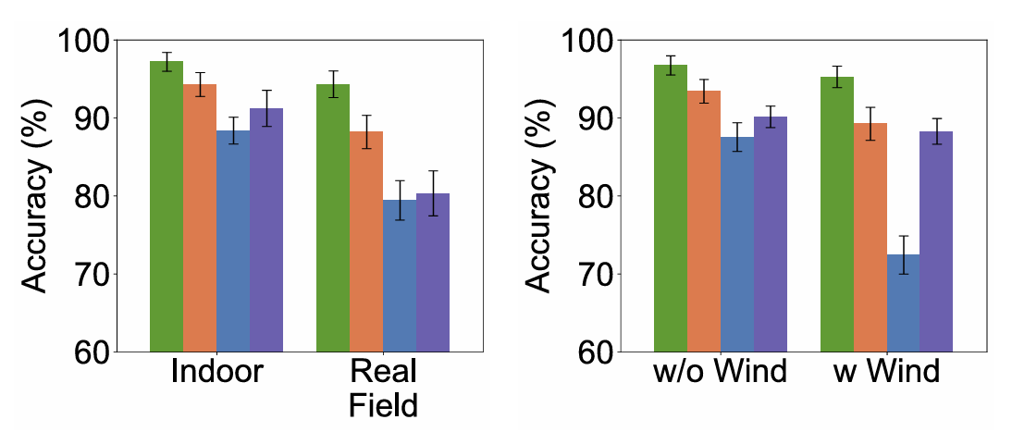
Evaluation
Proteus maintains robustness across different real field and mild wind scenario.
Notes:
In controlled indoor tests, Proteus achieves nearly 97% accuracy, outperforming baseline method.
When evaluated in a real farm environment, Proteus maintains a high accuracy, while Hydra drops to 88%, mmLeaf to 80%, and camera to 90% ​.
Under mild wind conditions, Proteus’s accuracy remains robust at 96%. This demonstrates Proteus’s resilience to environmental variability—crucial for reliable wetness monitoring in field deployments

Slide 17
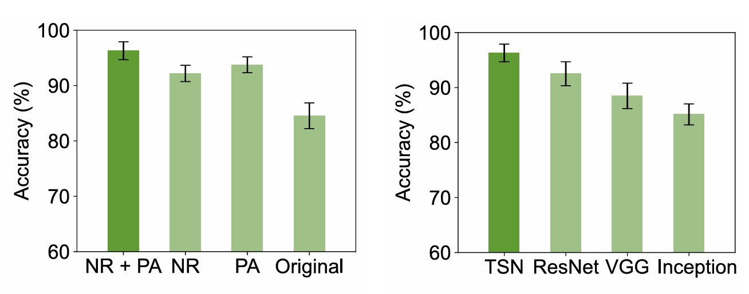
Evaluation
The ablation evaluation demonstrates the effectiveness of noise reduction,
phase angle enhancement, and the teacher-student network.
Notes:
Our ablation study quantifies each Proteus component’s impact.
On the left, the original SAR baseline scores around 85% accuracy. Adding phase‐angle 94%, applying noise reduction alone hits around 90%, and combining both reaches 96%.
On the right, we compare different student‐network backbones. Our show with teacher student network achieves 97% with other classification models.

Slide 18
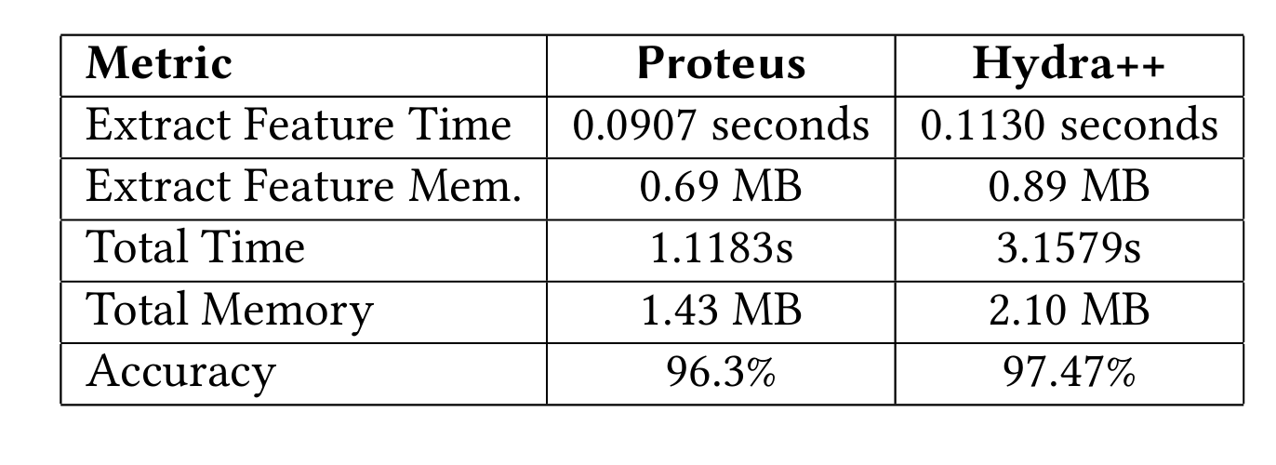
Evaluation
Proteus and Hydra++ provide alternative solutions for accurate leaf wetness detection tradeoff between accuracy and computation
Notes:
By adding our SAR enhancement steps into the Hydra fusion pipeline, we obtain Hydra++, which pushes accuracy up to 97.5 %—with 1.2 percentage above Proteus and higher latency 3.16 s and more memory usage.
This clearly illustrates the trade-off: you can with better marginal accuracy gains through multimodal fusion, or choose a lean design for real-time, edge-friendly performance .
Why Hydra better, mmWave more information thinking, what is better

Slide 19
Key Insights
SAR Image Enhancement: Combined Computer Vision method for denoising and phase-angle fusion to enhance surface features.
Cross-Modal Distillation: An RGB teacher guides a lightweight SAR student, transferring rich wetness cues into a compact radar-only model.
Trade-Off Frontier: Hydra++ (SAR + RGB) can reach high accuracy but high latency and more memory.
Notes:
In the end for the key insight
First, we design with SAR Image Enhancement that Combined Computer Vision method converts noisy SAR returns into a high‐SNR feature and we have phase-angle fusion to enhance surface features.
Second, by distilling an RGB‐trained teacher into a lightweight SAR student, we transfer rich visual wetness features into a compact radar‐only model,.
Finally, while fusing SAR and RGB in Hydra++ improve accuracy up to 97.5 %, it improve with more the latency and memory usage—making Proteus and Hydra++ as a tradeoff between system complexity and performance.

Slide 20
Proteus: Enhanced mmWave Leaf Wetness Detection
with Cross-Modality Knowledge Transfer
Yimeng Liu
liuyime2@msu.edu
Michigan State University

